Slide 1
TensorFlow Image Classification
by Berk Cetinsaya

Slide 2
Outline
How a Computer Reads an Image?
Why can't we use Fully Connected Networks for Image Recognition?
What is Convolutional Neural Network?
How Convolutional Neural Networks Work?
InceptionV3 Model

Slide 3
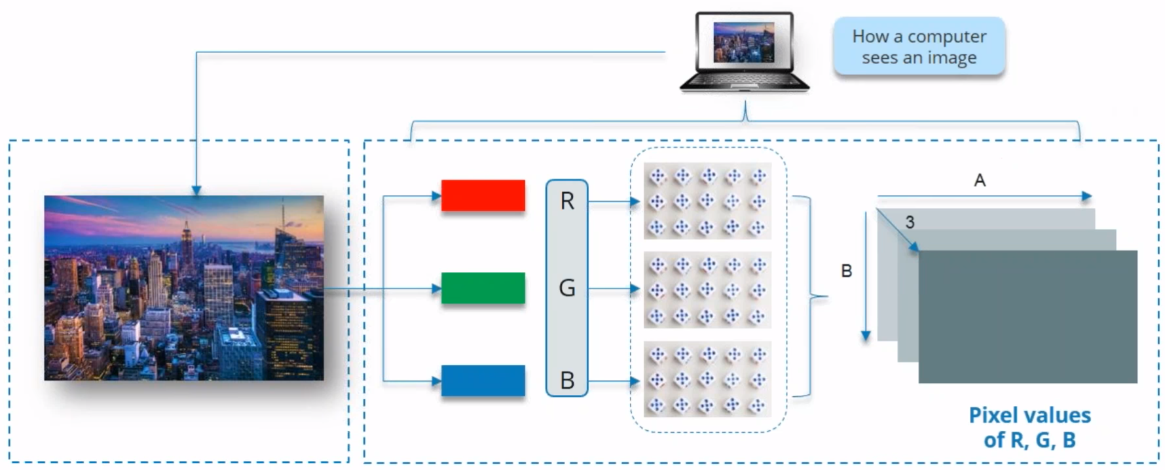
How a Computer Reads an Image?

Slide 4
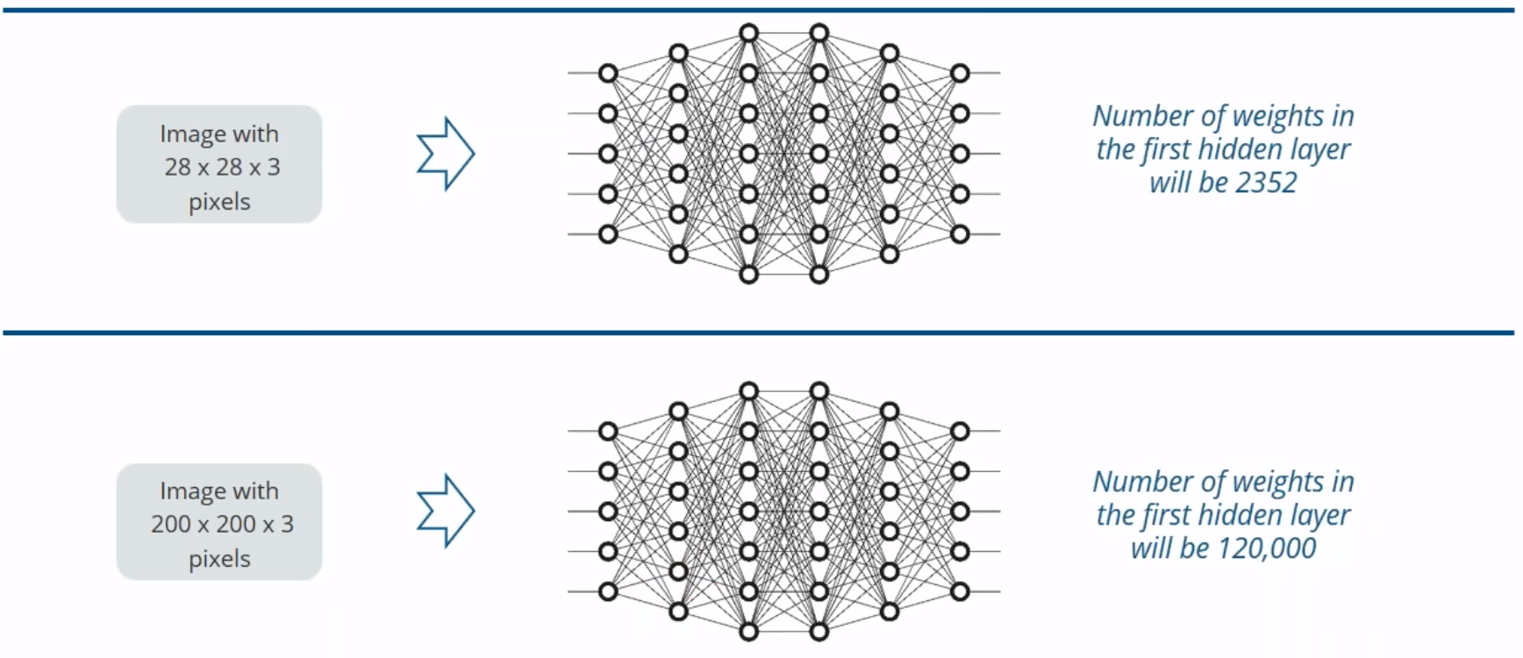
Why Not Fully Connected Networks

Slide 5
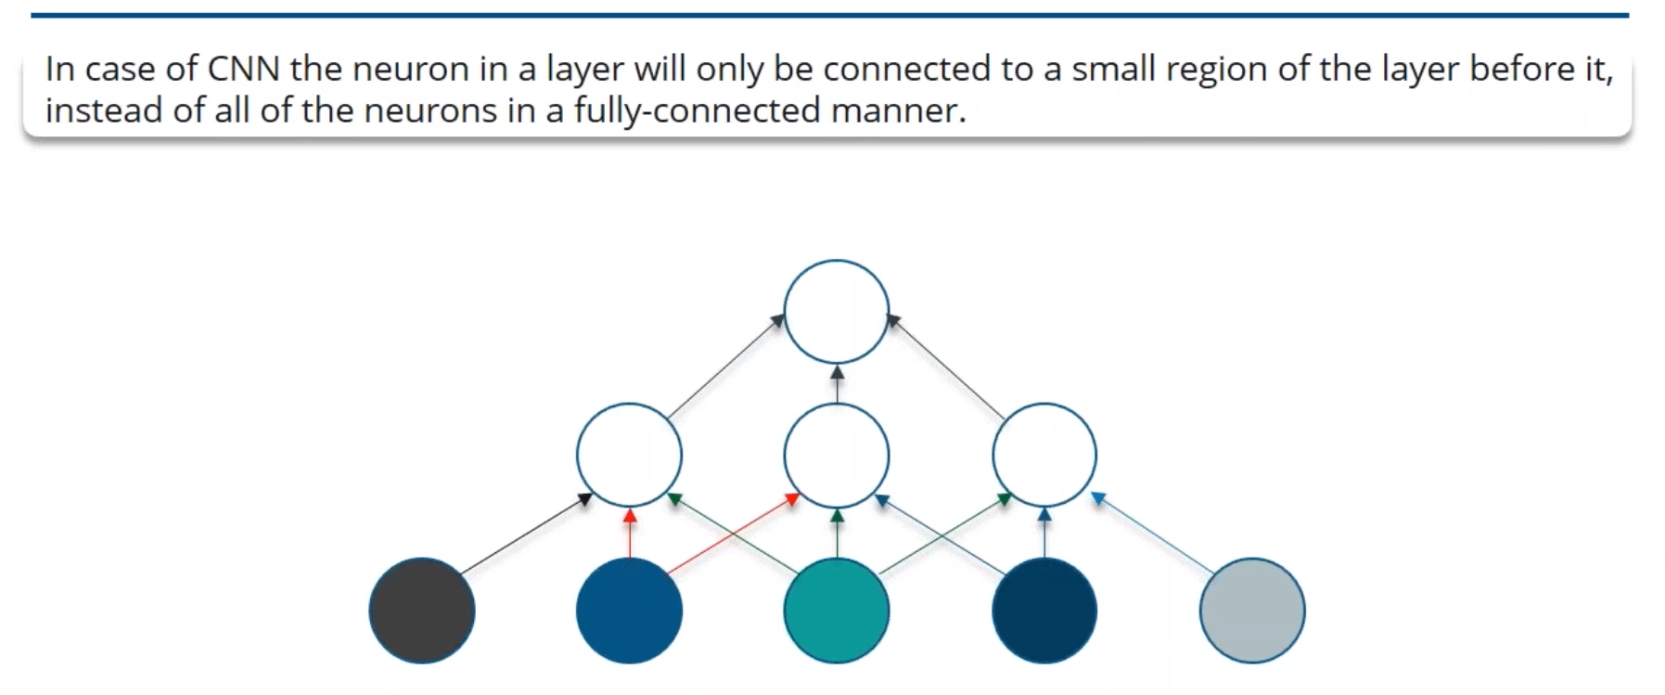
Why Convolutional Neural Network?

Slide 6
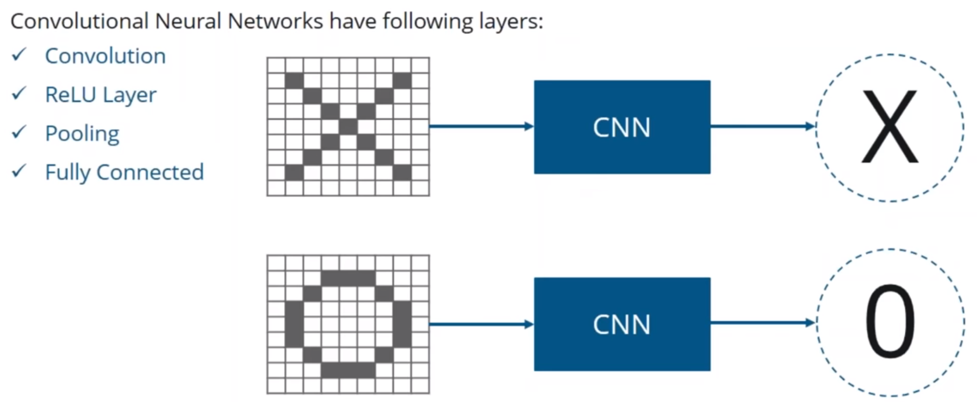
How CNN Works?

Slide 7
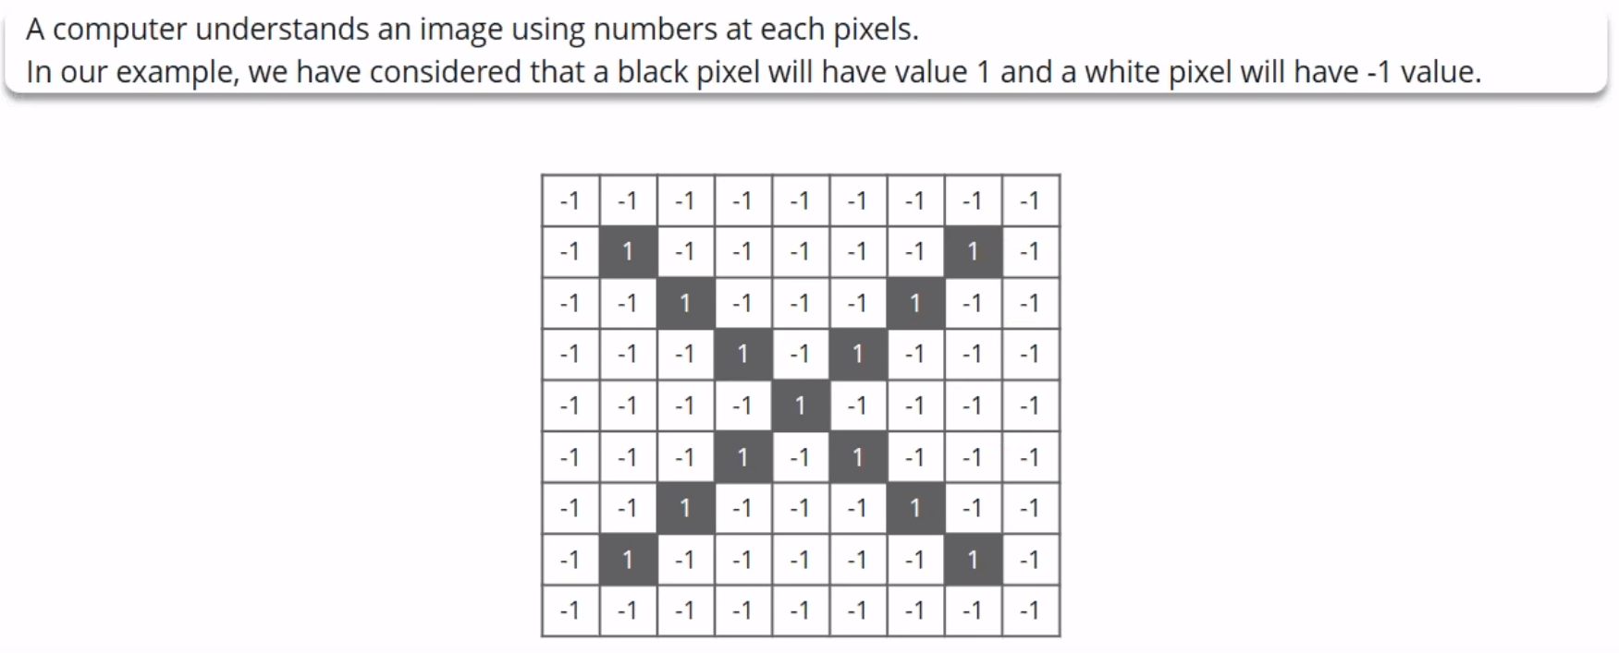
How CNN Works?

Slide 8
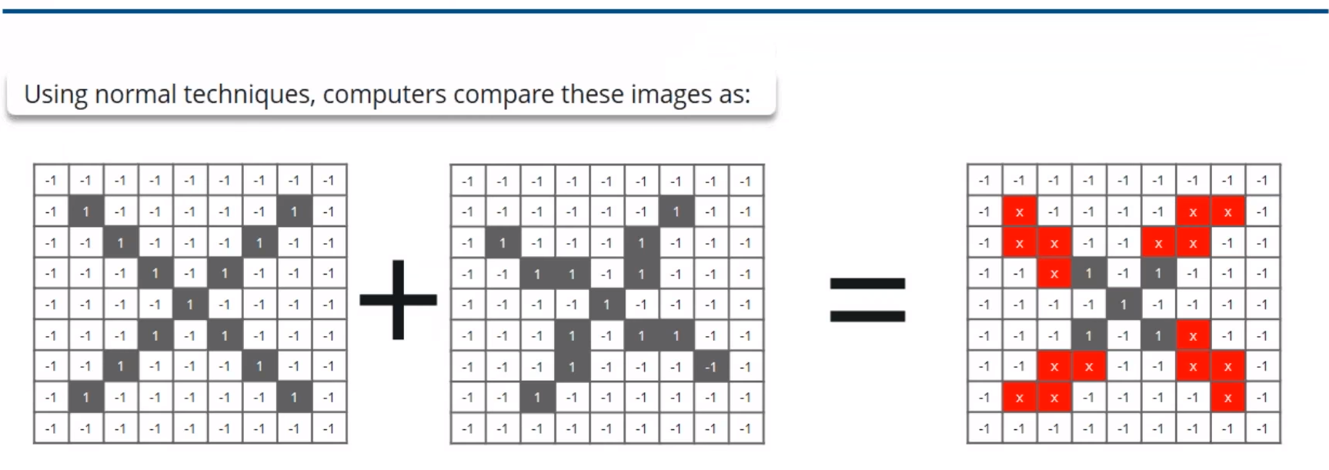
How CNN Works?

Slide 9
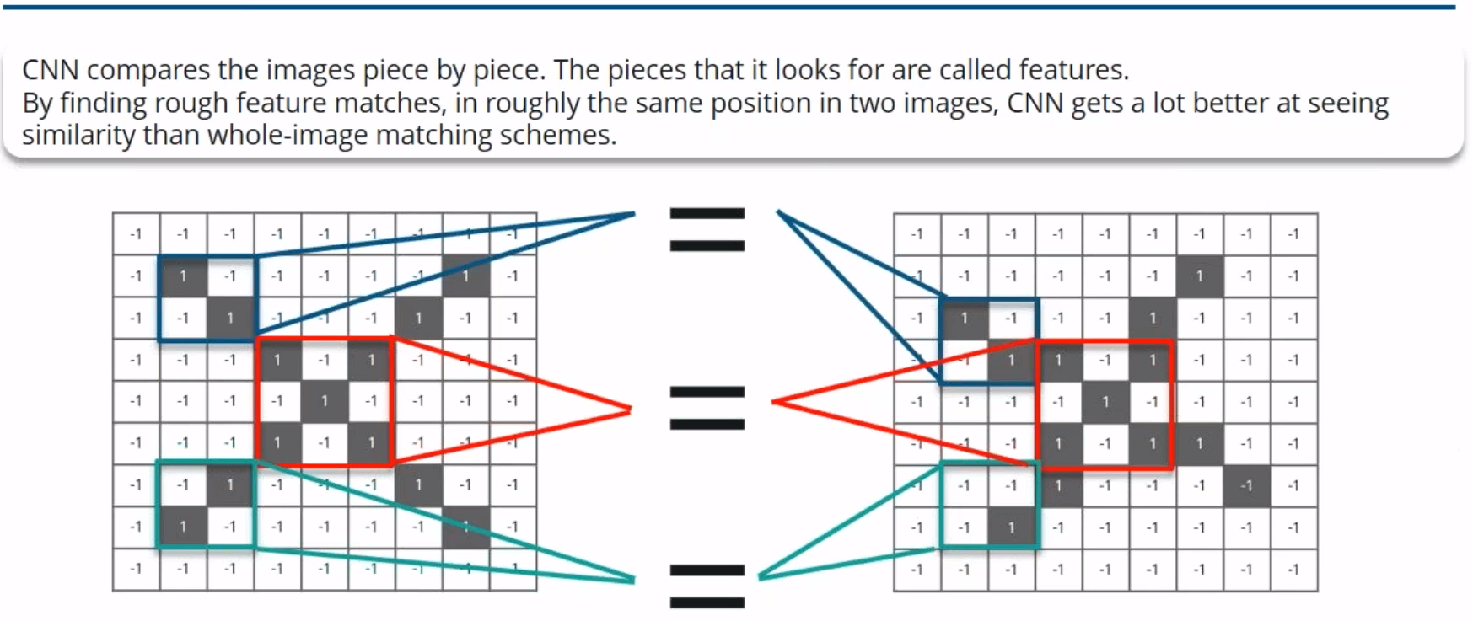
How CNN Works?

Slide 10
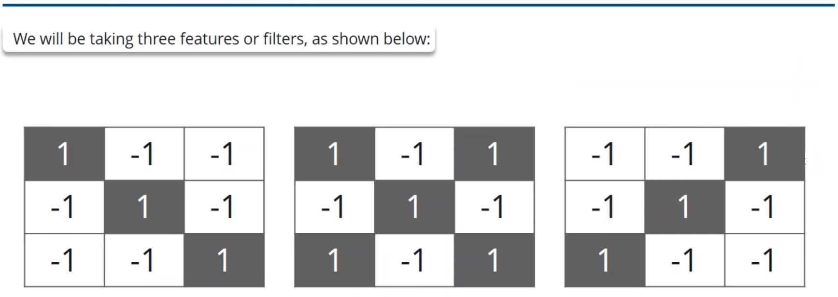
How CNN Works?

Slide 11
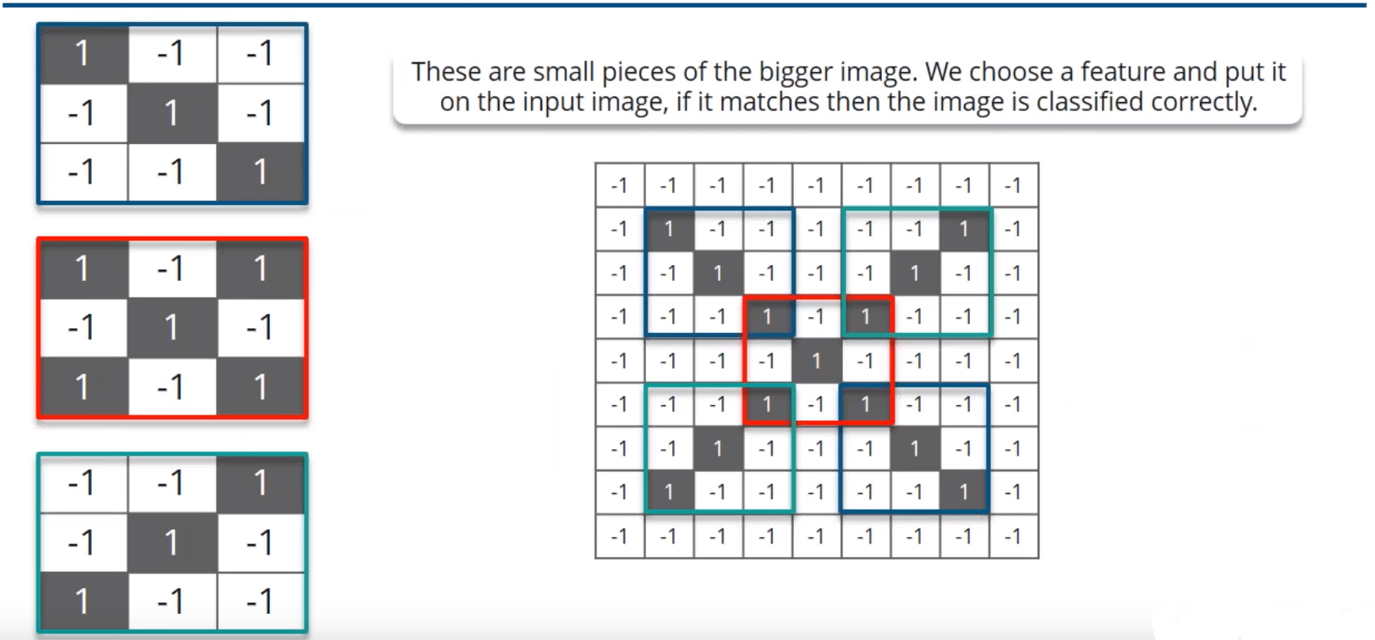
How CNN Works?

Slide 12
Convolution Layer

Slide 13
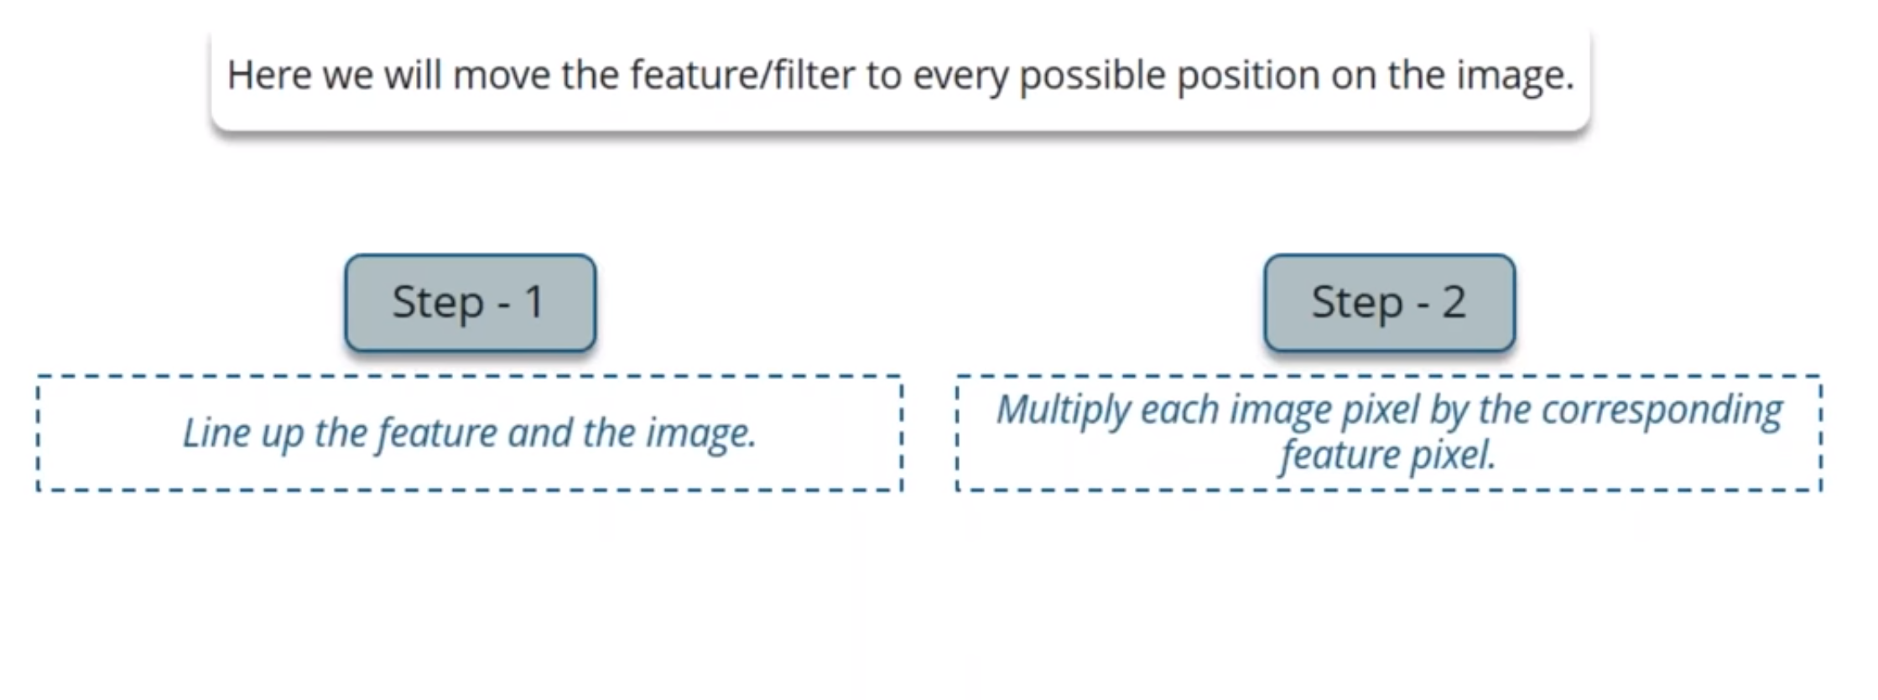
Steps Involved in Convolution Layer

Slide 14
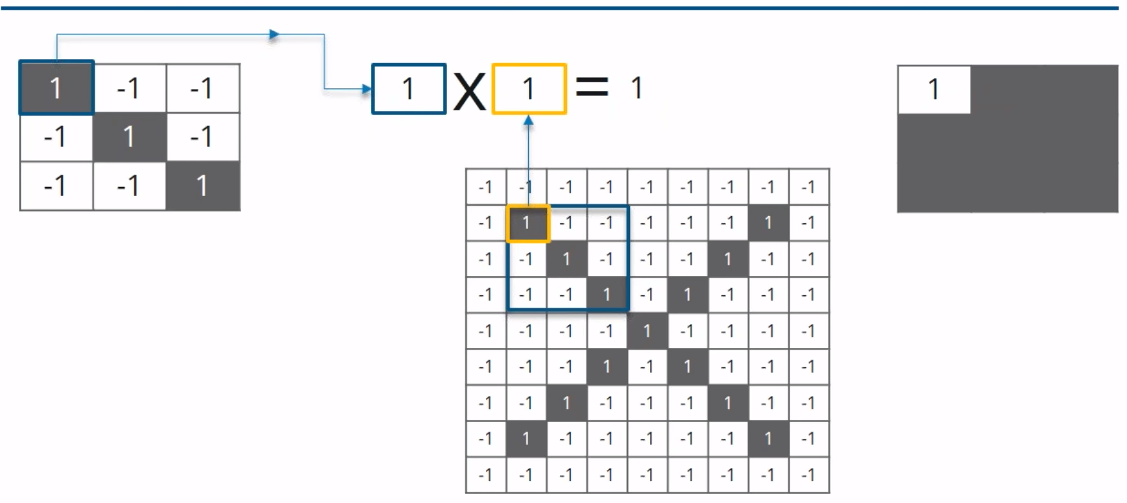
Multiplying the Corresponding Pixel Values

Slide 15
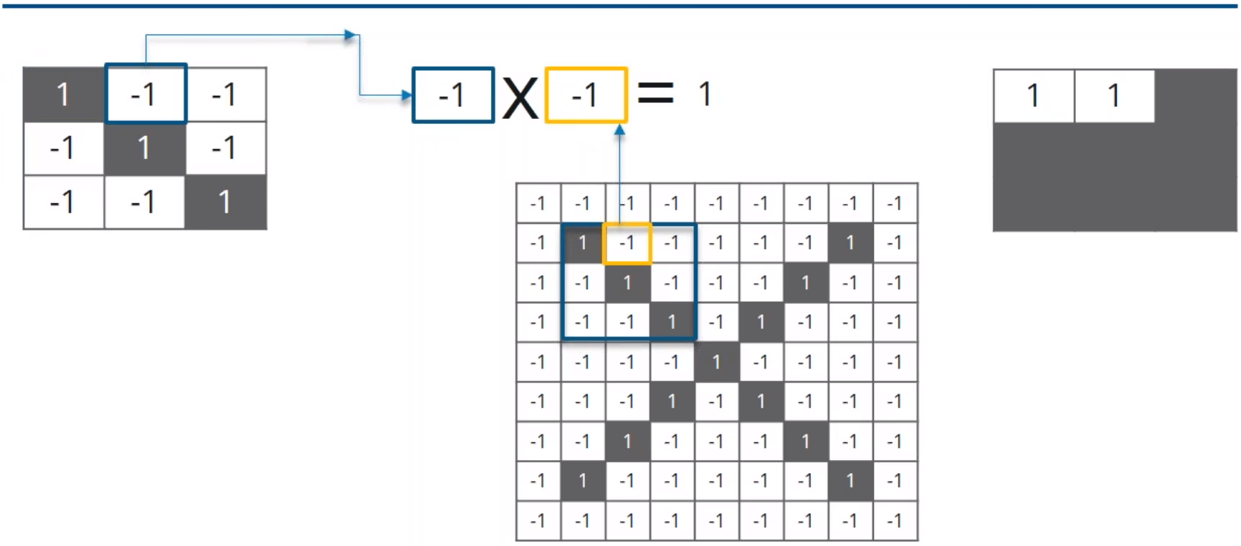
Multiplying the Corresponding Pixel Values

Slide 16
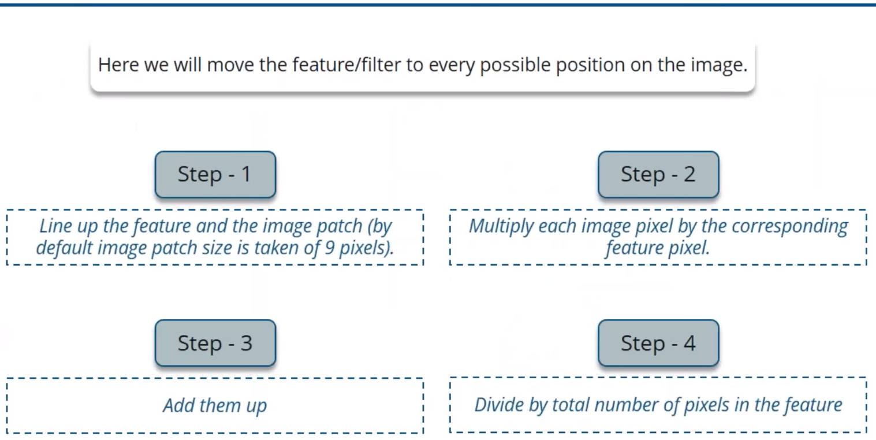
Steps Involved in Convolution Layer

Slide 17
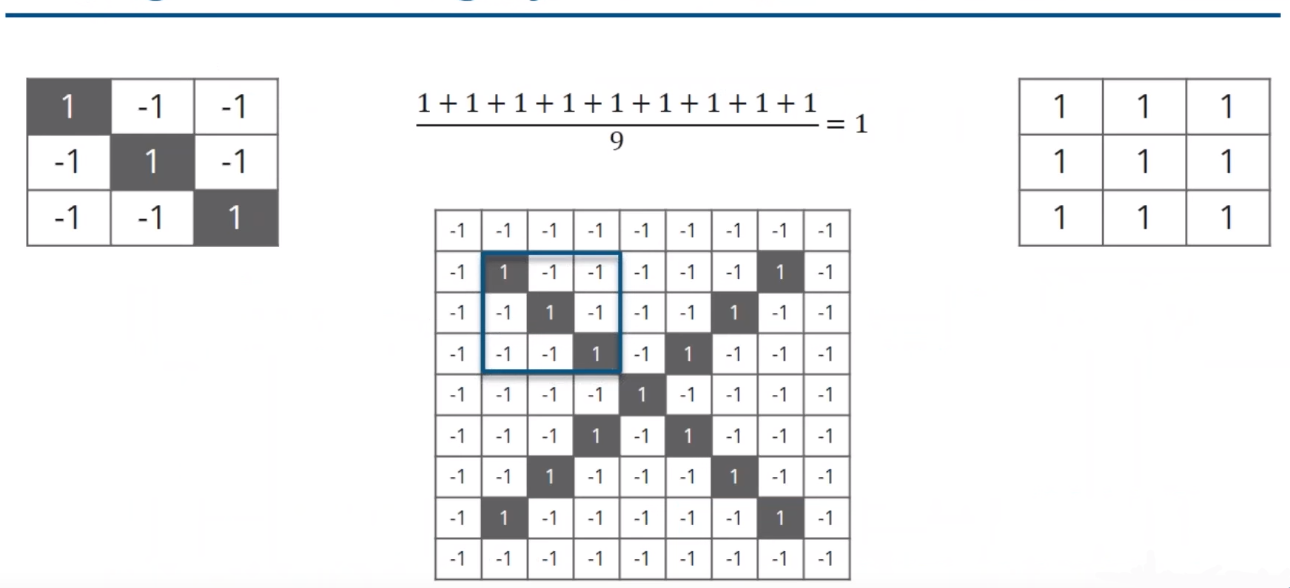
Adding and Dividing by the Total Number of Pixels

Slide 18
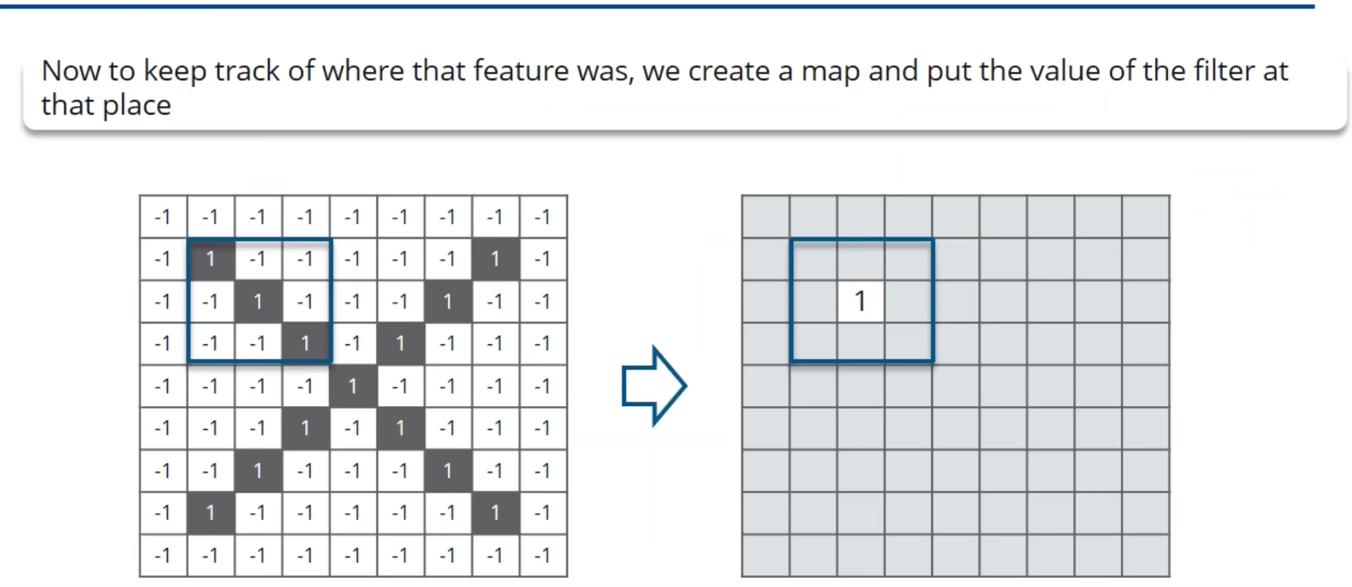
Creating a Map to Put the Value of the Filter

Slide 19
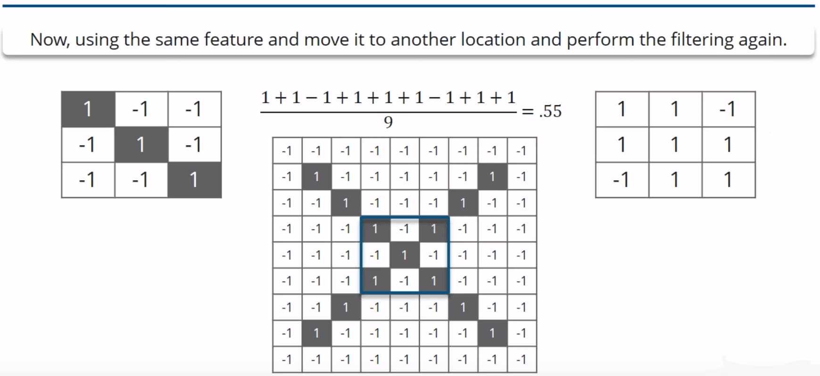
Sliding the Filter Throughout the Image

Slide 20
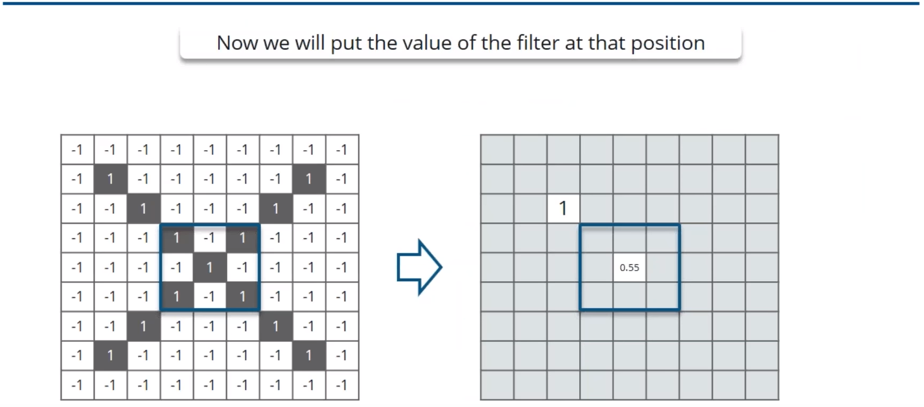
Convolution Layer

Slide 21
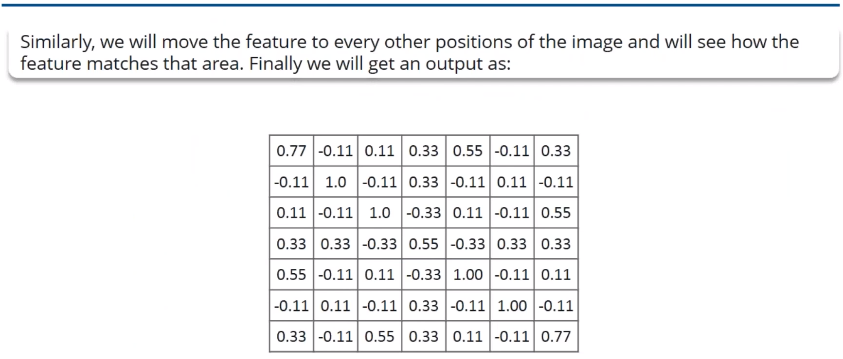
Convolution Layer Output

Slide 22
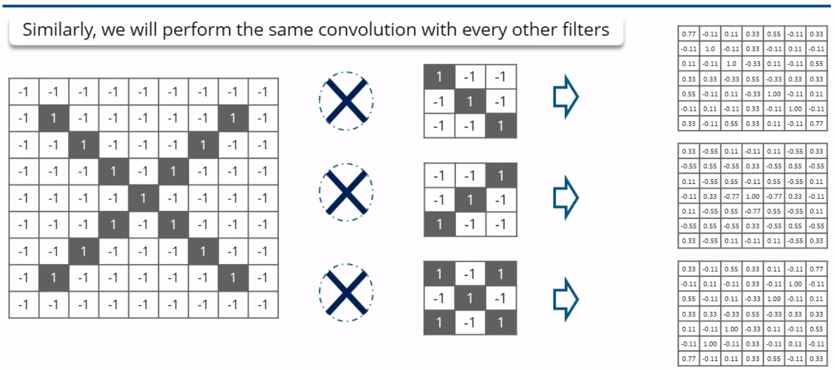
Convolution Layer Output

Slide 23
ReLU Layer

Slide 24
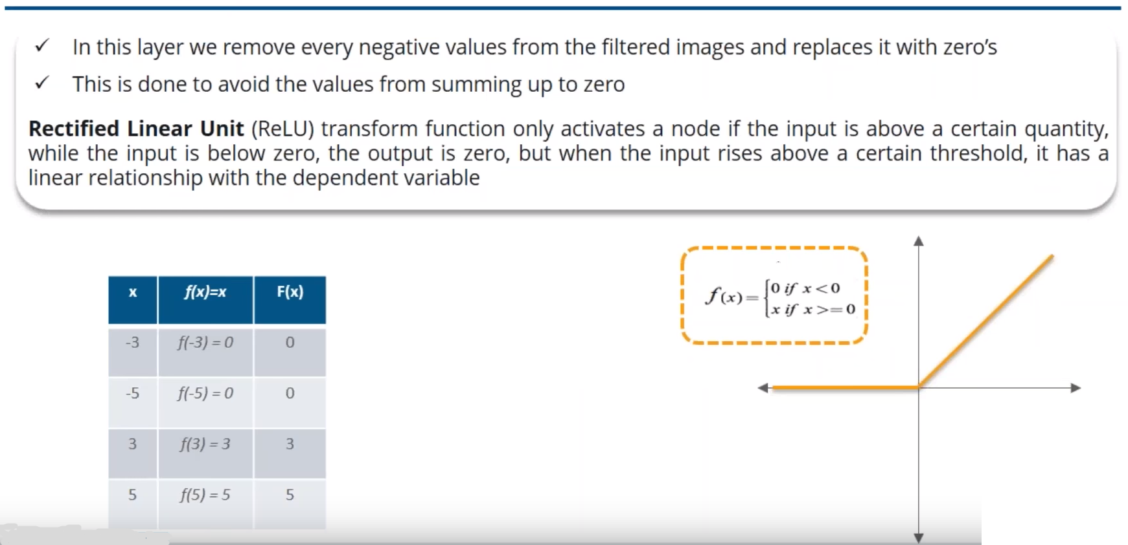
ReLU Layer

Slide 25
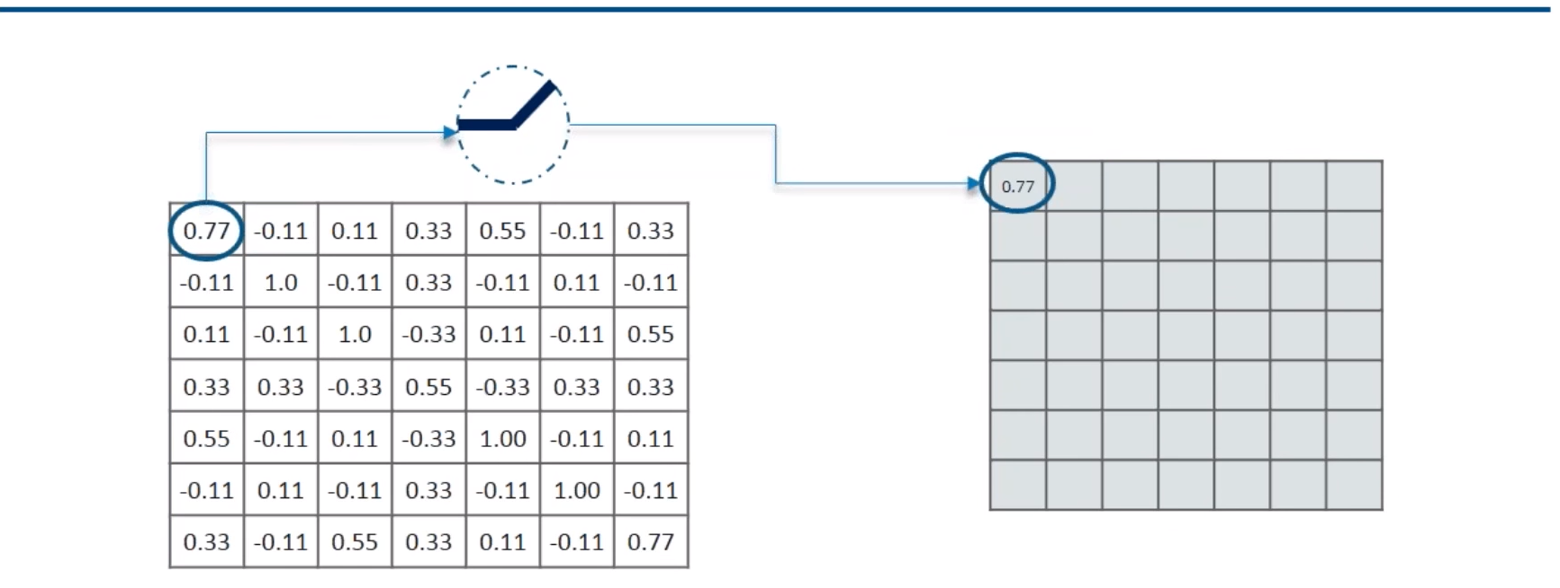
Removing the Negative Values

Slide 26
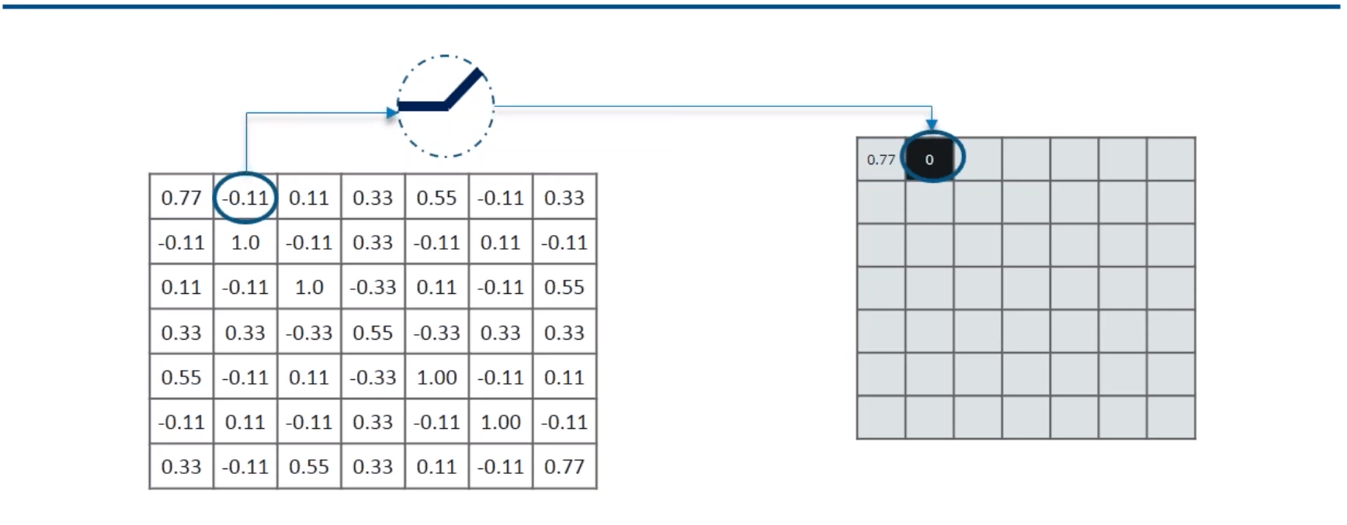
Removing the Negative Values

Slide 27
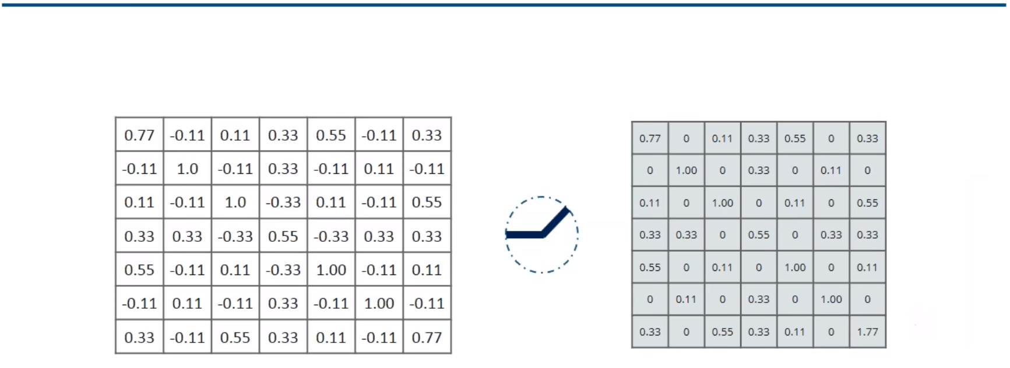
Output for One Feature

Slide 28
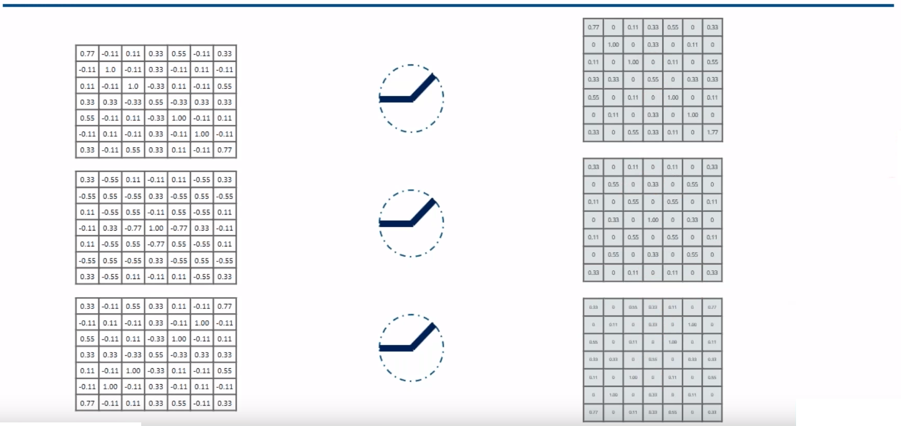
Output for All Features

Slide 29
Pooling Layer

Slide 30
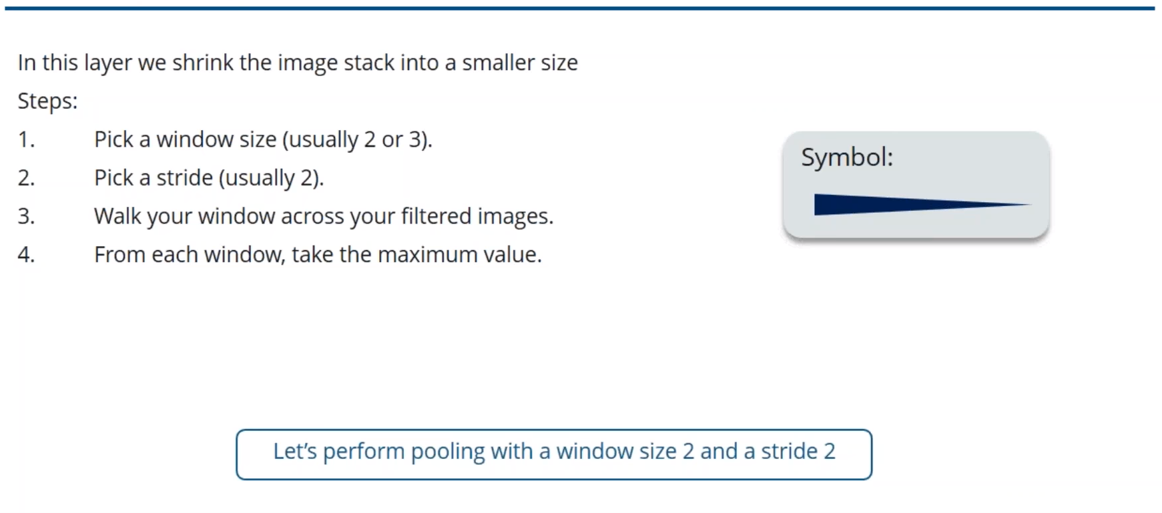
Pooling Layer

Slide 31
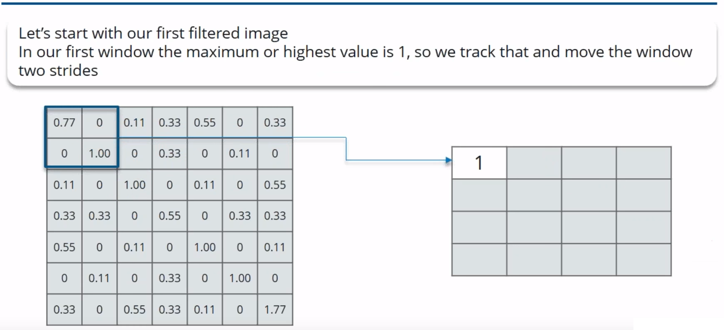
Calculating the Maximum Value in each Window

Slide 32
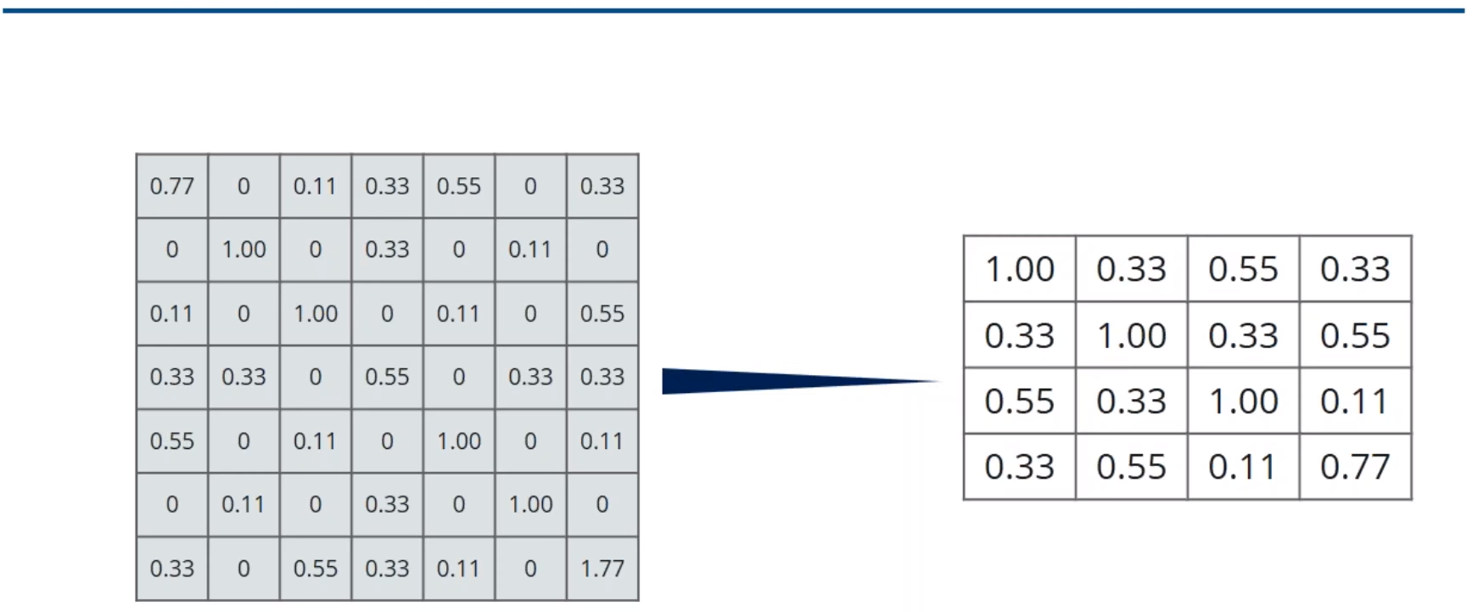
Moving the Window Across the Entire Image

Slide 33
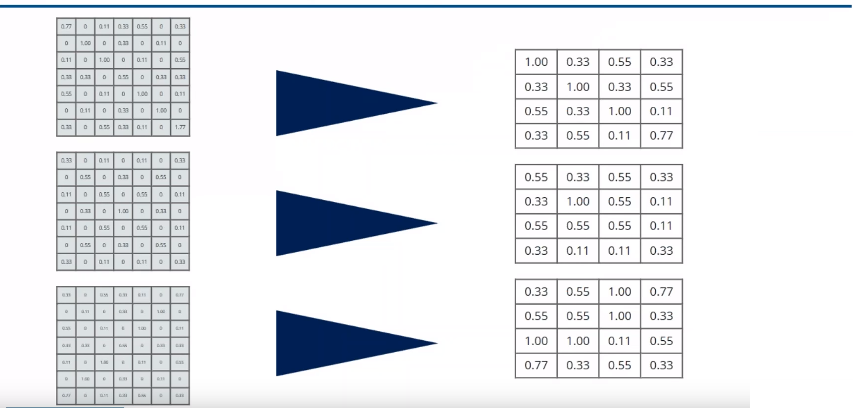
Output After Passing Through Pooling Layer

Slide 34
Stacking up the Layers

Slide 35
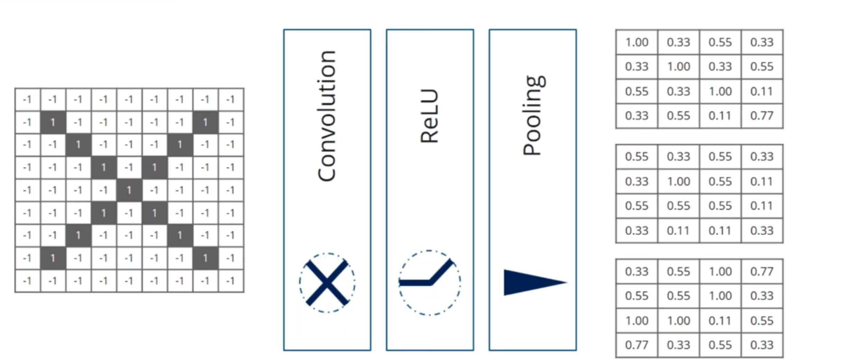
Stacking up the Layers

Slide 36
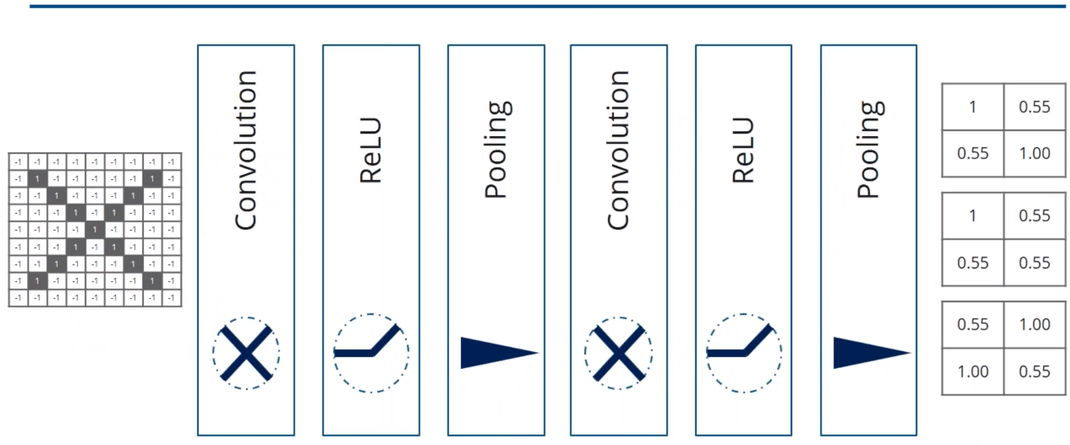
Stacking up the Layers

Slide 37
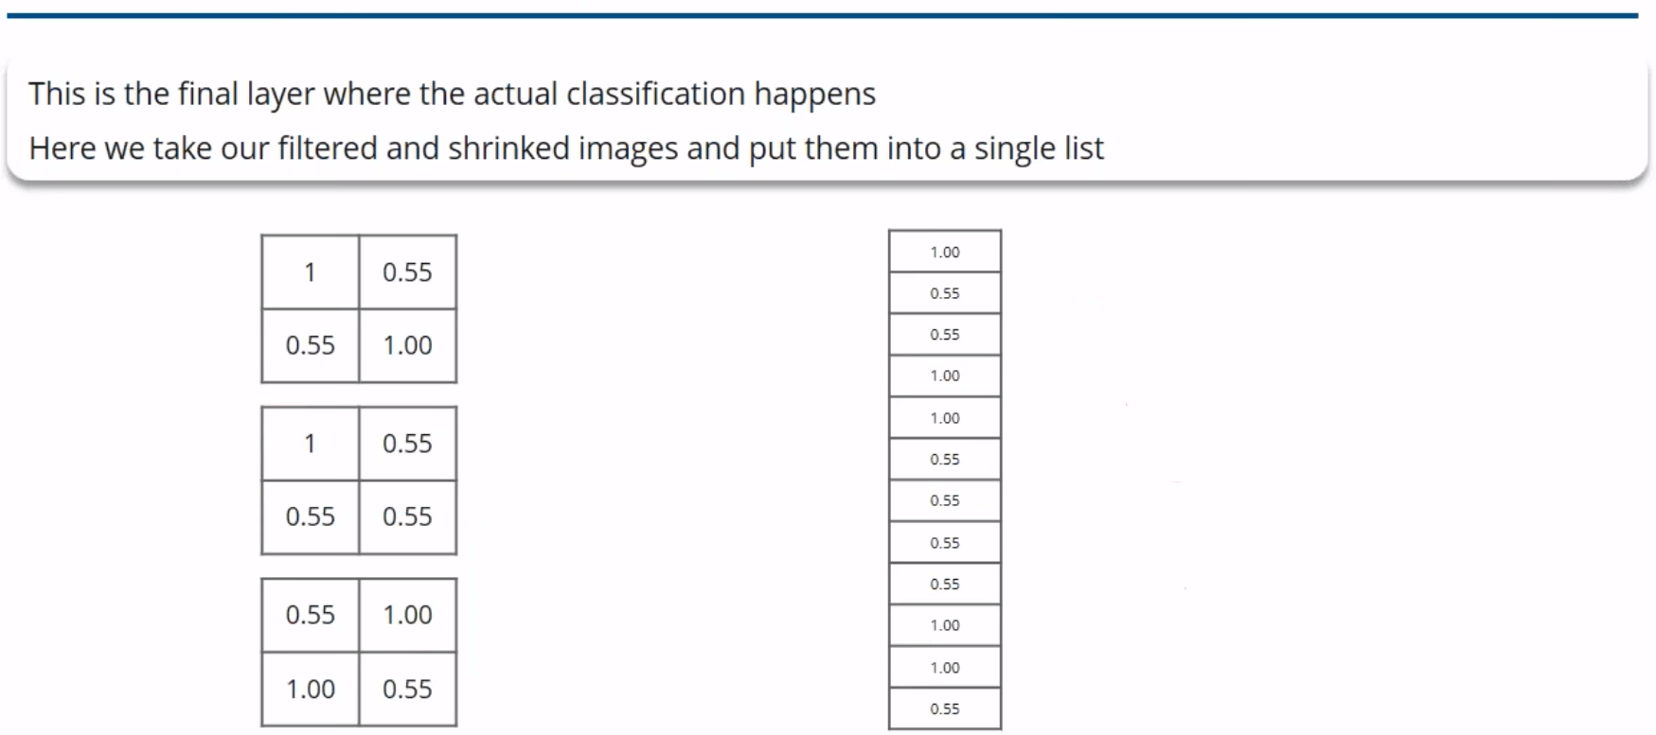
Fully Connected Layer

Slide 38
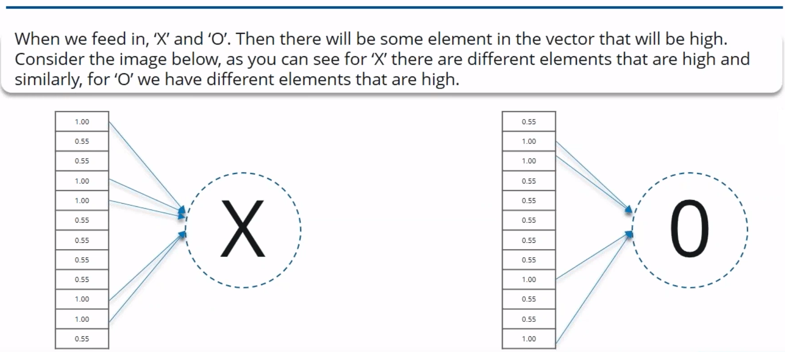
Output

Slide 39
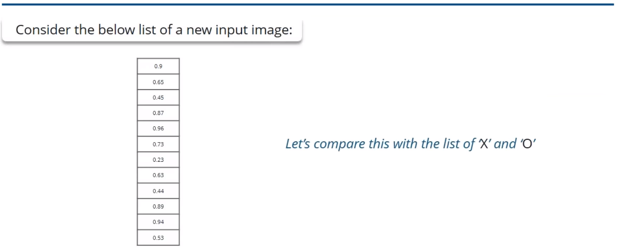
Prediction

Slide 40
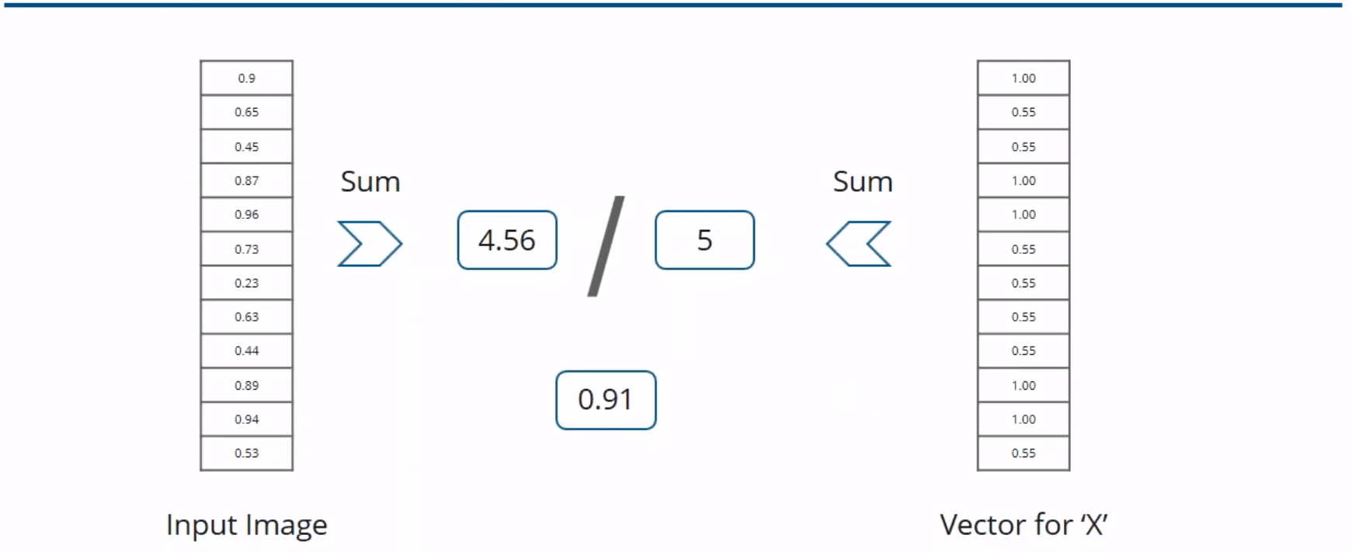









Comparing the Input Vector with X

Slide 41
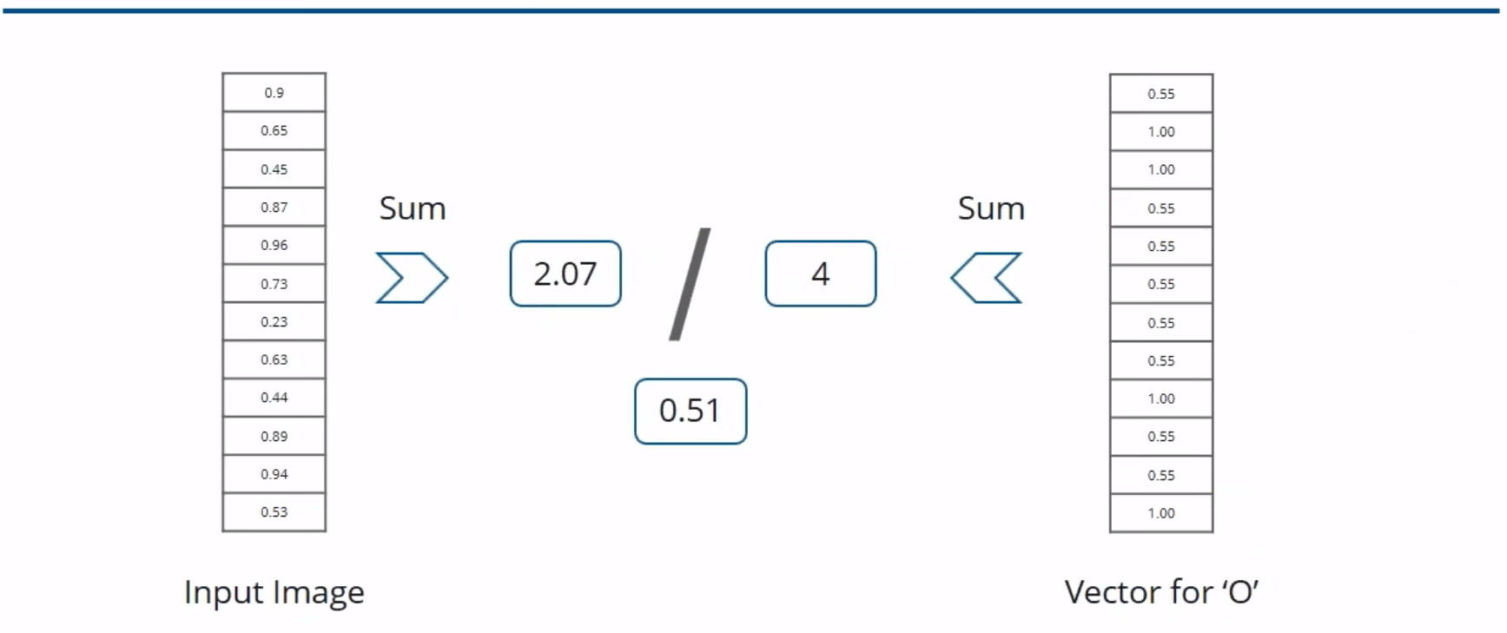








Comparing the Input Vector with O

Slide 42
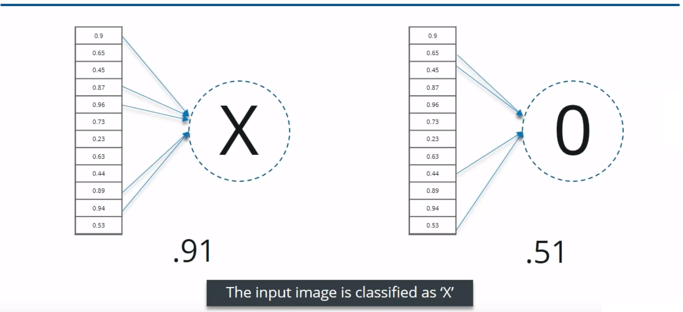
Result

Slide 43
Image Recognition with TensorFlow

Slide 44
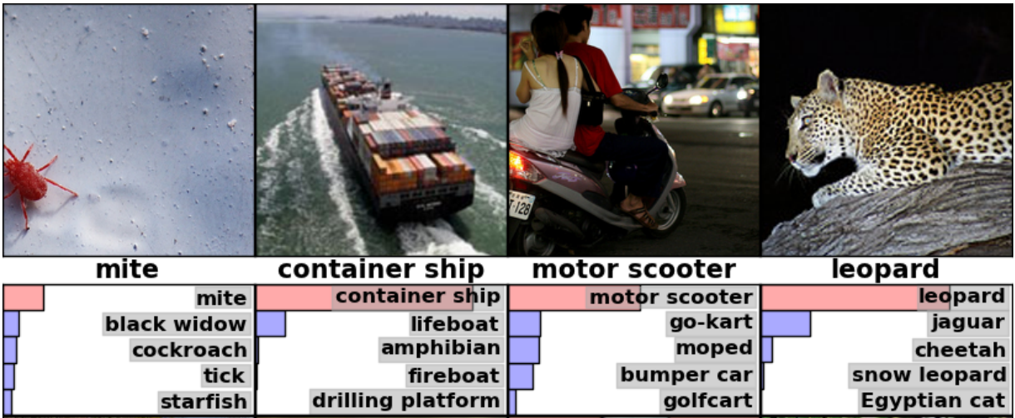
InceptionV3 Model
TensorFlow uses pre-trained InceptionV3 model
1.2 million images (1000 classes)
42 layers deep
Less than 25,000,000 parameters (neurons)
Uses rectified linear unit (ReLU) activation function

Slide 45
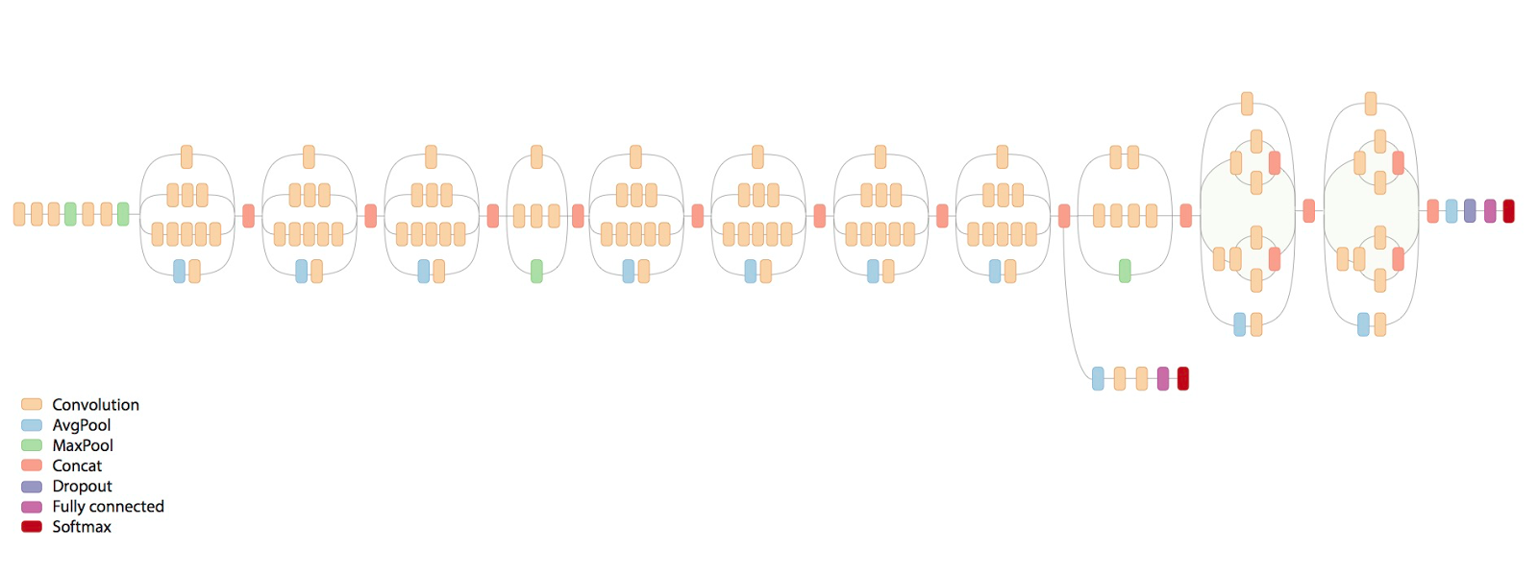
Schematic diagram of InceptionV3

Slide 46
TensorFlow flow graph

Slide 47
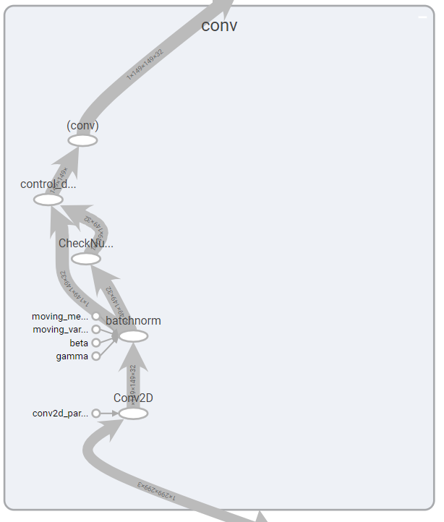


First Convolution Layer

Slide 48

Pooling layer

Slide 49
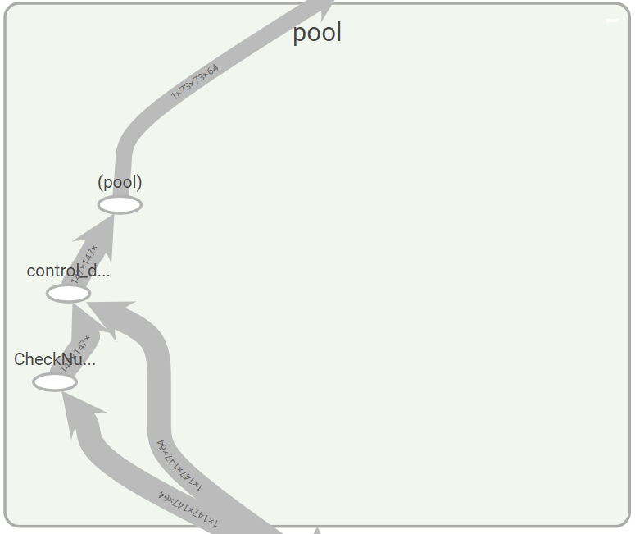


Pooling layer

Slide 50

Inception (Mixed) layer

Slide 51
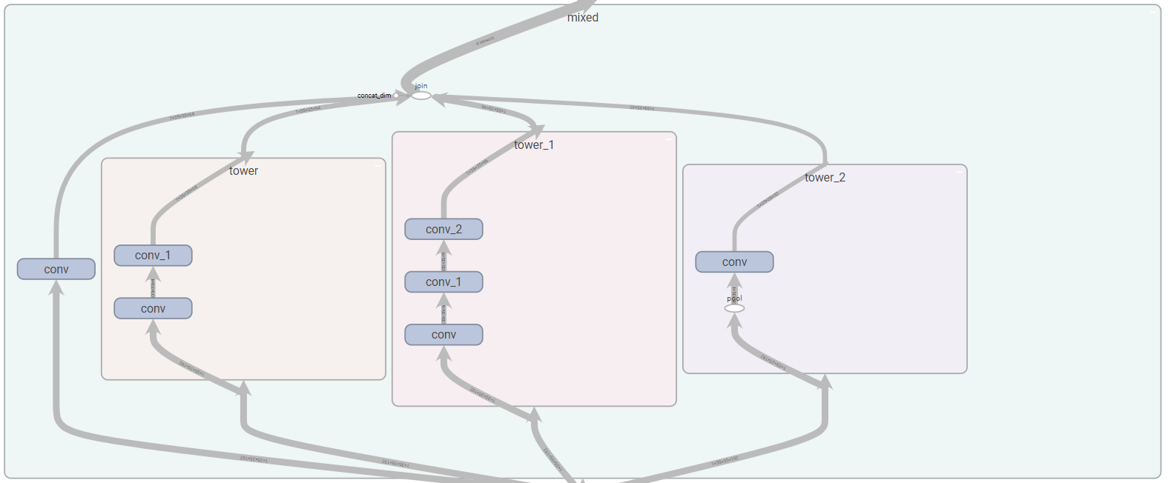
Inception (Mixed) layer

